Slide 1
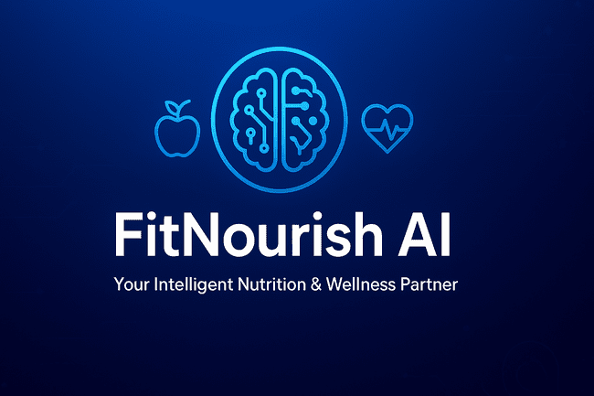
FitNourish AI – Intelligent Nutrition & Wellness Assistant
25-26J- 386

Slide 2
Research Problem
Poor dietary habits and a lack of personalized nutrition advice lead to health issues. Existing apps are not dynamic and ignore real-time health data.
Research Solution
FitNourish AI is an AI-powered nutrition assistant that gives personalized diet plans and health alerts. It uses:
Machine Learning to create meal plans from user data and smartwatch biometrics.
Image Processing & Computer Vision to suggest meal plans and analyze food photos.
Smart Grocery Optimizer to give budget-friendly shopping lists.
Wellness Monitoring to track habits and send health alerts.

Slide 3
Research Gap
A solution is needed that is intelligent, adaptive, and holistic, providing real-time, personalized dietary advice.
Main Objective
To develop an AI-powered assistant that provides personalized dietary recommendations, meal planning, and health monitoring to help users manage health conditions and achieve fitness goals.

Slide 4
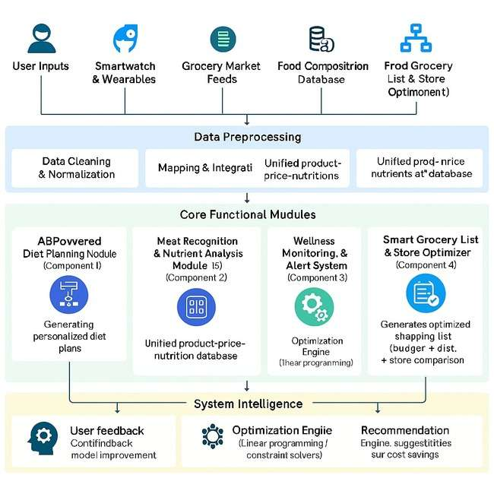

Slide 5

It22907684|Weerarathne h. P
AI-powered Multi-Disease Adaptive Nutrition and Personalized Health Optimization
SystemBSc (Hons) in Information Technology Specialization in Information Technology
IT22907684 | <<Weerarathne H.P>> | <<25-26J-386>>

Slide 6
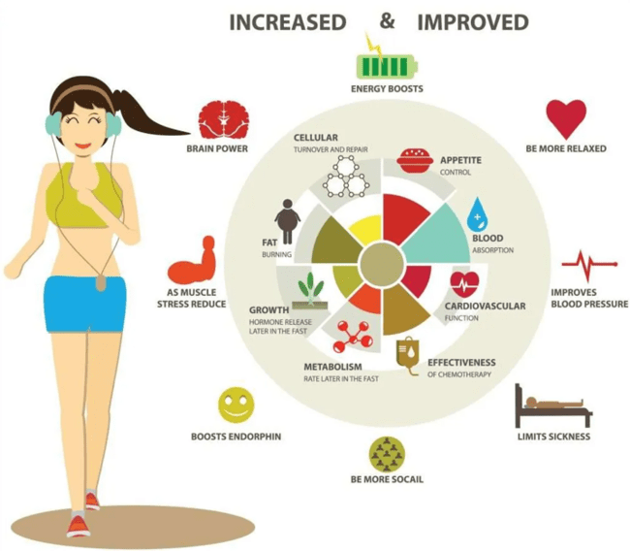
AI-powered Multi-Disease Adaptive Nutrition and Personalized Health Optimization
1. Problem
People have vastly different health goals. A person managing chronic diseases, an athlete building muscle, and someone seeking more energy all need unique nutritional guidance. Generic, one-size-fits-all diet apps fail everyone. They cannot resolve conflicting advice for medical conditions nor provide the precise personalization needed for high performance or general wellness. This leads to confusion, lack of results, and potential health risks.
IT22907684 | << Weerarathne H.P >> | << 25-26J-386 >>

Slide 7

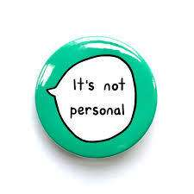


AI-powered Multi-Disease Adaptive Nutrition and Personalized Health Optimization
2. Gaps
A significant gap exists between generic technology and individualized nutritional needs. Current solutions fail because they are:
Not Safe Not Personal Not Holistic Not Transparent
IT22907684 | << Weerarathne H.P >> | << 25-26J-386 >>

Slide 8
AI-powered Multi-Disease Adaptive Nutrition and Personalized Health Optimization
Research Gap | Existing App Behavior | Proposed Solution
Safety & Medical boundaries | Apps like MyFitnessPal offer generic advice with no safeguards for users with conditions like diabetes or kidney disease, potentially suggesting harmful foods. | A Rule-Based Guardian encodes clinical guidelines to create absolute safety boundaries, preventing dangerous recommendations for all users.
Deep Personalization | Apps like Yazio provide static, one-size-fits-all plans based on simple formulas. They cannot adapt to a user's daily life or unique body. | An ML Optimizer analyzes the user's profile and real-time smartwatch data to create a dynamic, hyper-personalized plan that adapts daily.
Holistic Integration | Most apps (e.g., CaloriePal) focus only on food, ignoring the critical impact of activity, sleep, and stress on nutritional needs. | The system fuses live biometric data (sleep, activity, heart rate) with food logging to make holistic, context-aware recommendations.
Trust & Transparency | Current systems are "black boxes" that give commands without explanation, eroding user trust and adherence. | An Explainable AI (XAI) Interface provides simple, natural language justifications for every recommendation, building trust and educating the user.
IT22907684 | << Weerarathne H.P >> | << 25-26J-386 >>

Slide 9
AI-powered Multi-Disease Adaptive Nutrition and Personalized Health Optimization
3. Solution
I propose an AI-powered Multi-Disease Adaptive Nutrition and Personalized Health Optimization system. This is a hybrid AI platform designed to be a universal digital health partner. It works for everyone by first conducting a deep User Profile Analysis to understand their unique body, goals, and lifestyle. It then combines:
A Rule-Based "Guardian" that enforces absolute clinical safety for medical users and healthy boundaries for all users.
A Machine Learning "Optimizer" that personalizes plans within those boundaries based on continuous analysis of the user's profile and real-time biometric data.
It explains every recommendation in simple language, building trust and educating the user.
IT22907684 | << Weerarathne H.P >> | << 25-26J-386 >>

Slide 10
AI-powered Multi-Disease Adaptive Nutrition and Personalized Health Optimization
4. Key Domains
Data Science: To clean, manage, and fuse heterogeneous data from user profiles and sensors.
Machine Learning: To build the advanced personalization model that learns from each user.
Clinical Science & Sports Nutrition: To encode correct safety rules and performance principles.
Software Engineering: To build a reliable, scalable, and secure system.
Human-Computer Interaction: To design intuitive interfaces and clear, motivating explanations.
5. Latest Technologies
Python & FastAPI: To create the high-performance core engine and its API.
XGBoost: A leading machine learning algorithm for accurate and efficient predictions.
SHAP: A tool to explain the AI's decisions and make them transparent.
PostgreSQL & TimescaleDB: Databases to securely store user profile data and time-series biometric data.
Google Fit/Apple HealthKit: To connect seamlessly with a wide ecosystem of wearable devices.
Docker & AWS: To containerize and deploy the system reliably in the cloud.
IT22907684 | << Weerarathne H.P >> | << 25-26J-386 >>

Slide 11
AI-powered Multi-Disease Adaptive Nutrition and Personalized Health Optimization
6. Proof of Success
Accuracy: The AI's predictions must be within 10% of established energy expenditure calculations for fitness goals and clinical guidelines for medical goals.
Safety: A 0% violation rate of pre-defined health constraints during rigorous testing.
User Adherence & Satisfaction: A high score (>80/100) on the System Usability Scale (SUS) and positive feedback from a diverse user group (medical, fitness, wellness).
Functional Prototype: A working API and a demo application that proves all key features.
7. Data & Ethics
Privacy by Design: All personal data is anonymized, encrypted, and owned solely by the user. It is never sold.
Informed Consent & Transparency: Users are clearly informed about how their data is used and must provide explicit, granular consent.
Bias Mitigation: The ML model is trained on diverse datasets to ensure fair and effective recommendations for all body types, ages, and backgrounds.
Positive Advocacy: The system promotes healthy, sustainable habits and avoids recommendations that could lead to unhealthy body images or eating disorders.
IT22907684 | << Weerarathne H.P >> | << 25-26J-386 >>

Slide 12
AI-powered Multi-Disease Adaptive Nutrition and Personalized Health Optimization
6. Data Availability Data Availability
Primary Data Source – UK Biobank
Demographics: Age, sex, weight, height ✅
Medical Conditions: Chronic diseases such as diabetes, hypertension, CKD ✅
Biometric & Lab Data: HbA1c, cholesterol, creatinine, blood glucose ✅
Physical Activity Data: Accelerometer-based step count, sleep, heart rate ✅
Nutrient Intake Patterns: Food frequency questionnaires ✅
Health Outcomes: Long-term follow-up on weight and disease progression ✅
Coverage
500,000+ participants → ensures diversity and generalizability
De-identified data → compliant with privacy & ethics standards
Limitations & External Sources
❌ No real-time wearable data → handled during deployment via Apple HealthKit/Google Fit
❌ No clinical thresholds → addressed using WHO, ADA, AHA guidelines
Rule Thresholds → WHO / ADA / AHA guidelines (clinical thresholds)
Deployment Phase → Apple HealthKit & Google Fit APIs(Wearable Data)
IT22907684 | << Weerarathne H.P >> | << 25-26J-386 >>

Slide 13
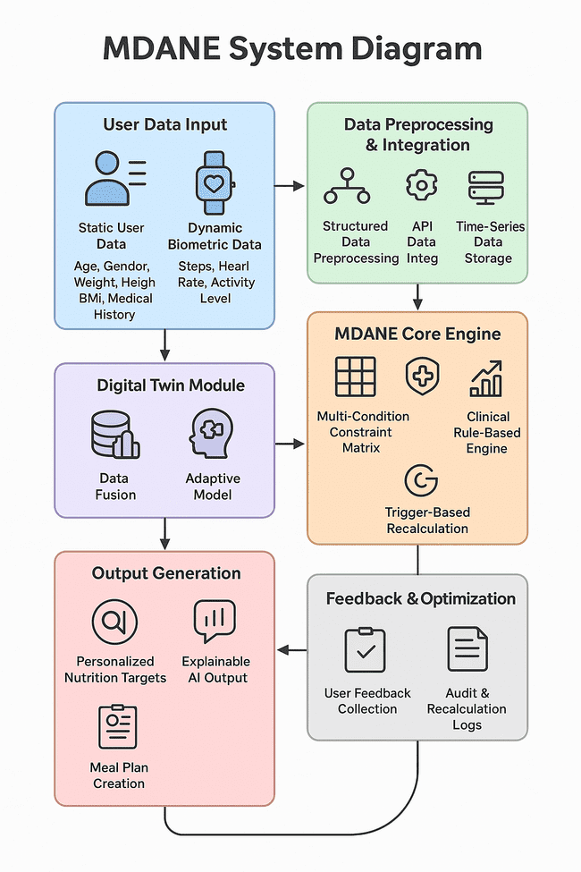
AI-powered Multi-Disease Adaptive Nutrition and Personalized Health Optimization
IT22907684 | << Weerarathne H.P >> | << 25-26J-386 >>

Slide 14
AI-powered Multi-Disease Adaptive Nutrition and Personalized Health Optimization
Real-world Example
Maria, 68 Medical 🏥 | Alex, 28 Fitness 💪 | Sam, 42 Wellness ⚡
Profile: Type 2 Diabetes, Kidney Disease Goal: Manage Health | Profile: Amateur Bodybuilder Goal: Build Muscle Mass | Profile: Busy Professional, Fatigue Goal: Improve Daily Energy
The Problem: Conflicting dietary needs create confusion and risk. | The Problem: Generic plans lack the precision for optimal performance. | The Problem: Energy crashes from poor food choices and lifestyle mismatch.
How Our AI Helps: • Guardian: Locks potassium & carb limits. • Optimizer: Uses activity data to fuel walks. • Explains: "Added healthy fats for energy, kept it kidney-friendly." | How Our AI Helps: • Guardian: Ensures safe protein intake. • Optimizer: Boosts calories/protein based on workout strain. • Explains: "+400 cal & 50g protein for muscle repair after your lift."* | How Our AI Helps: • Guardian: Promotes balanced meals. • Optimizer: Analyzes sleep & activity to prevent crashes. • Explains: "Lunch with slow-release energy to prevent your 3 PM slump."*
IT22907684 | << Weerarathne H.P >> | << 25-26J-386 >>

Slide 15
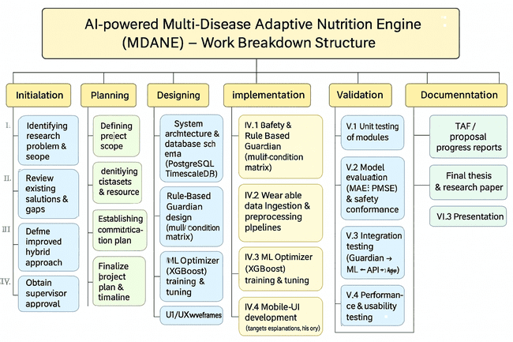
Work Breakdown Structure
AI-powered Multi-Disease Adaptive Nutrition and Personalized Health Optimization
IT22907684 | << Weerarathne H.P >> | << 25-26J-386 >>

Slide 16

IT22343352 | Ekanayake M Y R
AI-powered Dynamic Meal Generator and Visual Ingredient Identifier
BSc (Hons) in Information Technology Specialization in Information Technology
IT22343352 | Ekanayake M.Y.R| 25-26J-386

Slide 17
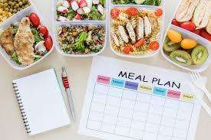
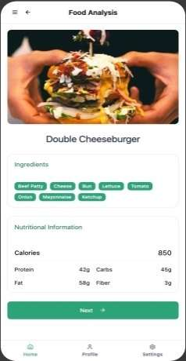

AI-powered Dynamic Meal Generator and Visual Ingredient Identifier
Problem
The global rise in lifestyle diseases like obesity and diabetes.
Traditional meal tracking (like food diaries) is difficult, slow, and often inaccurate.
Solution
Build an AI based mobile App to analyze food data and provide personalized nutrition guidance.
AI
IT22343352 | Ekanayake M.Y.R| 25-26J-386

Slide 18
AI-powered Dynamic Meal Generator and Visual Ingredient Identifier
Research Gaps
Current apps either analyze food or give meal plans, but they don't do both in a smart, integrated way. ​
Existing solutions don't provide warnings about unhealthy foods with reasoning.
Research Gap | Existing App behaviour | Proposed Solution
Data Quality | MyFitnessPal uses manual data entry or barcode scanning | Input food images by uploads
Food Analysis | Cal Pal only predicts calories | Predicts calories , nutrients and ingredients
Personalization & Unhealthy Warnings | Yazio has no alternative food suggestions or warnings | Suggest alternative foods & warnings based on user profile

Slide 19
AI-powered Dynamic Meal Generator and Visual Ingredient Identifier
Key Domains
Image Processing & Computer Vision
Machine Learning
Mobile & Backend Development
Latest Technologies
Image Processing
Convolutional Neural Network (CNN)
Machine Learning algorithms like XGBoost or LightGBM
IT22343352 | Ekanayake M.Y.R| 25-26J-386

Slide 20
AI-powered Dynamic Meal Generator and Visual Ingredient Identifier
Main Objective
To implement an AI powered App for personalized meal management
Sub Objectives
Data & Ethics
Data collection – we use publicly available datasets to train our models
Data Privacy – use strong security to protect all sensitive user data
Transparency – app will be designed to explain why it gives certain recommendations. It helps build user trust.
Data Collection and Management | Visual Analysis System
Personalization Engine | System Validation and Optimization
User Interface Design
IT22343352 | Ekanayake M.Y.R| 25-26J-386

Slide 21
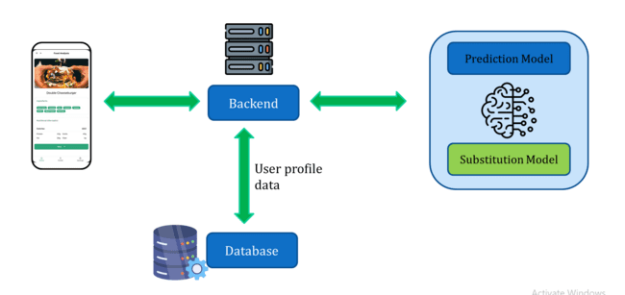
AI-powered Dynamic Meal Generator and Visual Ingredient Identifier
System Overview
A Real-world Example
User takes a picture of the meal and upload to the app
App recognizes the nutrients, ingredients off the app and predicts calories
It will provide alternative personalized food suggestions if meal is unhealthy
IT22343352 | Ekanayake M.Y.R| 25-26J-386

Slide 22
AI-powered Dynamic Meal Generator and Visual Ingredient Identifier
Work Breakdown Structure
1.
2.
3.
4.
5.
6.
Initialization
Planning
Designing
Implementation
Validation
Documentation
1.1
2.1
3.1
4.1
5.1
6.1
Identify the Problem
Requirement Gathering
System Design
Prediction Model
Model evaluation
TAF document
Find existing Solutions
Unit Testing
6.2
1.2
2.2
3.2
4.2
5.2
Project Proposal
Finding Dataset
UI Design
Substitution Model
1.3
4.3
Find Better Solution
2.3
Finalize Project Plan
Backend
5.3
6.3
Integration Testing
Research Paper
4.4
5.4
UI development
Performance Testing
5.

Slide 23

It22343420 | T.M Poornima
BSc (Hons) in Information Technology Specialization in Information Technology
Neural Network Based Health Outcome Prediction Using Multi Domain Time Series Data
IT22343420 | T.M Poornima | 25-26J-386

Slide 24
Research Gap
Neural Network Based Health Outcome Prediction Using MultiDomain Time Series Data
Lack of Integrated Multi-Domain Modeling
Overreliance on Static / Short-Term Data
Limited Model Explainability
Dimension | Existing Apps | Proposed System
Data Quality | MyFitnessPal – manual entry or barcode scan | Input food/activity data and logs automatically; wearable + nutrition logs integration
Food Analysis | CalPal – only predicts calories | Predicts calories, nutrients, and ingredient balance
Personalization & Warnings | Yazio – no personalized alternatives or risk warnings | Gives personalized suggestions and unhealthy food warnings (e.g., high sodium, fatigue risk)
Prediction Ability | Mostly static tracking apps | Uses time-series deep learning (LSTM/GRU) for future trend prediction
IT22343420 | T.M Poornima | 25-26J-386

Slide 25
Neural Network Based Health Outcome Prediction Using MultiDomain Time Series Data
Research Problem
Existing health prediction models often focus on single domains (only nutrition, only activity, or only BMI), which limits accuracy and comprehensiveness.
Most models analyze static data snapshots instead of continuous time-series data, making them less effective for early risk detection.
Lack of explainability in deep learning models reduces user trust and clinical acceptance.
Research Question(AI powered health prediction system)
How can deep learning models (LSTM/GRU) be used to integrate nutrition, calorie intake, weight, BMI, and physical activity data to accurately predict health outcomes?
How can explainable AI improve trust and usability in personalized health prediction systems?
IT22343420 | T.M Poornima | 25-26J-386

Slide 26
Neural Network Based Health Outcome Prediction Using MultiDomain Time Series Data
Specific Objectives
Develop a neural network–based predictive model using longitudinal multi-domain health data.
Detect early health risks such as nutrient imbalances, obesity, and fatigue.
Implement explainability (SHAP/LIME) to improve transparency and trust.
Provide a user-friendly dashboard for personalized recommendations.
Sub-Objectives
Preprocess and normalize time-series nutrition and activity datasets.
Apply transfer learning for robustness on small datasets.
Compare model performance (LSTM, GRU, baseline ML models).
Evaluate with metrics such as RMSE, MAE, and F1-score.
IT22343420 | T.M Poornima | 25-26J-386

Slide 27
Neural Network Based Health Outcome Prediction Using MultiDomain Time Series Data
Key Domains
Artificial Intelligence & Data Science
Health Informatics
Software Development
Latest Technologies
LSTM and GRU for time-series prediction
SHAP and LIME for explainable AI
Secure cloud database with visualization dashboard
IT22343420 | T.M Poornima | 25-26J-386

Slide 28
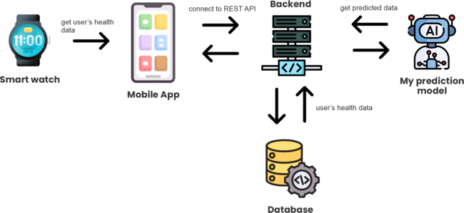
System Overview
Neural Network Based Health Outcome Prediction Using MultiDomain Time Series Data
IT22343420 | T.M Poornima | 25-26J-386

Slide 29
Neural Network Based Health Outcome Prediction Using MultiDomain Time Series Data
A Real-world Example
User logs their meals and daily activity into the app.
The system predicts weight changes and shows nutrient balance (e.g., high sodium, low protein).
If a risk is detected, it warns the user early and suggests healthier options.
Healthcare professionals can also check reports to monitor patient health trends.
IT22343420 | T.M Poornima | 25-26J-386

Slide 30
Neural Network Based Health Outcome Prediction Using MultiDomain Time Series Data
Core Functionalities of the System
User Data Input – Users can log nutrition, calories, activity, weight, and BMI.
Prediction Engine – Neural network model forecasts weight trends and health risks.
Risk Detection – Detects issues like high sodium intake, fatigue risk, or obesity.
Explainable Results – Provides clear reasons for predictions using SHAP/LIME.
Dashboard & Visualization – Displays trends, predictions, and alerts in a user-friendly interface.
Data Security & Privacy – Secure storage and controlled access to user health data.
IT22343420 | T.M Poornima | 25-26J-386

Slide 31
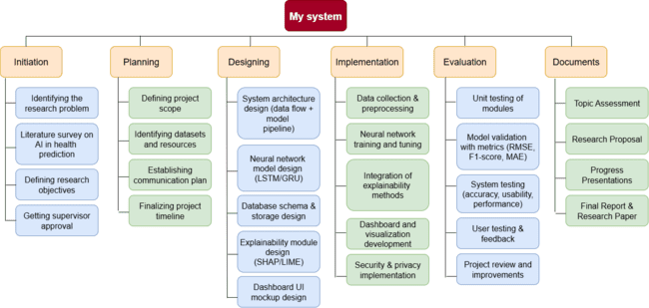
Work breakdown structure
Neural Network Based Health Outcome Prediction Using MultiDomain Time Series Data
IT22343420 | T.M Poornima | 25-26J-386

Slide 32
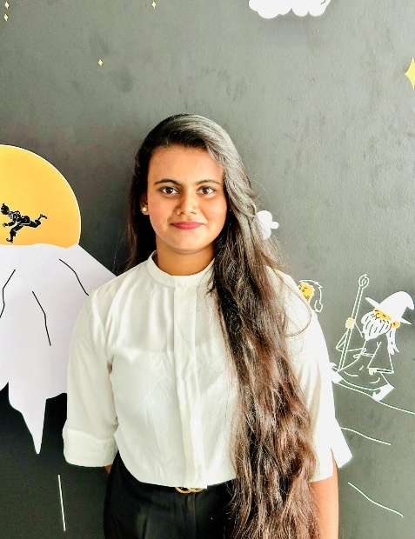
IT22343284 | SAMARAWICKRAMA T.N
AI-powered Smart Grocery List Optimization and Nearest Store Recommendation
BSc (Hons) in Information Technology Specialization in Information Technology
IT22343284 | Samarawickrama T.N | 25-26J-386

Slide 33
AI-powered Smart Grocery List Optimization and Nearest Store Recommendation
Research Problem :
Rising food prices and limited focus on affordability make healthy eating difficult in Sri Lanka.
Existing global apps lack support for local foods and cultural diets.
No integrated AI-powered solution combines nutrition, cost, and nearest store availability.
Solution :
Build an AI-powered grocery optimizer that creates budget-friendly, nutrition-aware shopping lists using local price data, with smart substitutions and nearest store recommendations to balance health, cost, and availability.
IT22343284 | Samarawickrama T.N | 25-26J-386

Slide 34
AI-powered Smart Grocery List Optimization and Nearest Store Recommendation
Research Gap :
Research Gap | Existing App Behaviour | Proposed Solution
No integration of real-time grocery prices | MyFitnessPal, Yazio, Cal Pal – focus on calories only, no real-time price data | Integrate Sri Lankan grocery price data
Limited focus on affordability & budget planning | Samsung Health – health tracking only, ignores affordability | Optimize grocery lists to stay within user budget
Lack of support for Sri Lankan food culture & diets | Global apps – focus on Western foods, no local adaptation | Include Sri Lankan foods with local substitutions
No system combining health, cost & store recommendations | Global apps – no store/location optimization | Provide nearest store suggestions while balancing health & cost
IT22343284 | Samarawickrama T.N | 25-26J-386

Slide 35
AI-powered Smart Grocery List Optimization and Nearest Store Recommendation
Key Domains :
Artificial Intelligence & Machine Learning (NLP, clustering, optimization)
Data Science (market price analysis, data integration, and geolocation data processing for nearest store insights.)
Software Engineering (APIs for price and store data, visualization of optimized lists with store suggestions.)
Latest Technologies:
NLP to extract and classify grocery items from meal plans.
Clustering algorithms (K-Means/DBSCAN) to suggest product substitutions and group similar items.
Budget optimization algorithms (Linear Programming) to minimize costs while maintaining nutrition.
Geolocation & Mapping APIs (Google Maps API) to recommend the nearest or most cost-effective stores.
IT22343284 | Samarawickrama T.N | 25-26J-386

Slide 36
AI-powered Smart Grocery List Optimization and Nearest Store Recommendation
Main Objectives :
Develop an AI-powered grocery list optimizer that combines local prices, dietary filters, substitutions, and nearest store recommendations to generate budget-friendly, nutrition-aware shopping lists.
Sub Objectives :
Data Collection and Preprocessing
Grocery List Generation
Dietary and Nutritional Filters
Real-Time Budget Optimization
Nearest or cost-effective store suggestions.
User Interface Development
IT22343284 | Samarawickrama T.N | 25-26J-386

Slide 37
AI-powered Smart Grocery List Optimization and Nearest Store Recommendation
Data Availability:
HARTI (Hector Kobbekaduwa Agrarian Research and Training Institute) Daily bulletins → market price data.
DCS (Department of Census and Statistics ) reports → Weekly Retail Prices for selected Consumer Items.
Central Bank of Sri Lanka (CBSL) → Daily price reports offers official daily retail and wholesale price major markets.
World Food Prices Dataset (WFP) → historical & comparative commodity prices across Sri Lanka.
Nutrition databases → WHO, MRI (Medical Research Institute Sri Lanka) , Sri Lanka Food Composition Database (FCDB).
Supermarket websites → product names, categories, and prices.
Store location datasets / Supermarket APIs → nearest store availability and location-based pricing.
IT22343284 | Samarawickrama T.N | 25-26J-386

Slide 38
AI-powered Smart Grocery List Optimization and Nearest Store Recommendation
Real-World Application:
Households: Generate healthy and affordable weekly grocery lists.
Students: Get nearest store suggestions with cheapest options.
Patients (e.g., diabetic, vegetarian): Apply dietary filters within budget.
Retail/Nutrition sector: Support clinics, NGOs, and stores with cost-aware meal planning.
IT22343284 | Samarawickrama T.N | 25-26J-386

Slide 39
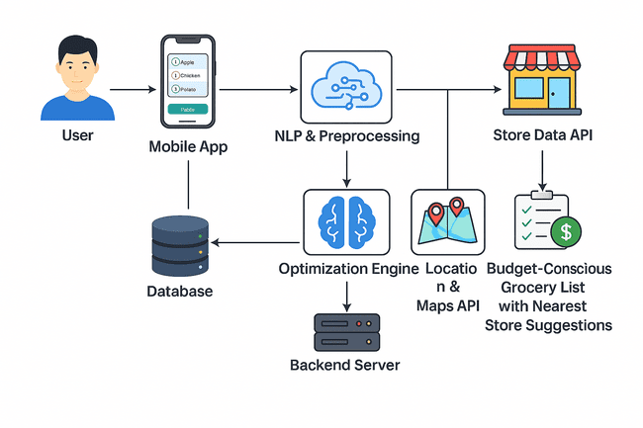
AI-powered Smart Grocery List Optimization and Nearest Store Recommendation
Component Diagram
IT22343284 | Samarawickrama T.N | 25-26J-386

Slide 40
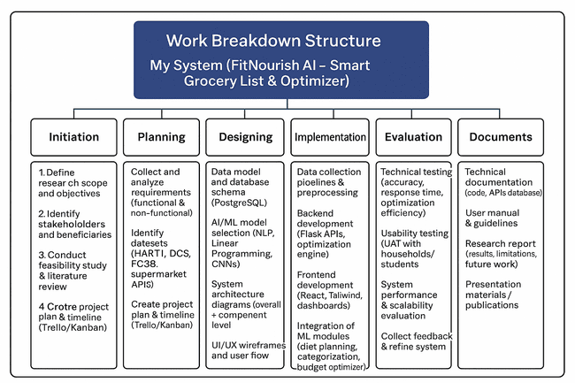
AI-powered Smart Grocery List Optimization and Nearest Store Recommendation
IT22343284 | Samarawickrama T.N | 25-26J-386

Slide 41
Commercialization Potential
Commercialization Potential: The MDANE engine has significant business value:
Market: Targets the growing personalized health & multi-morbidity management market.
Revenue Models: B2C subscription app; B2B2C SaaS licensing to clinics, corporate wellness programs, and insurance companies.
USP(Unique Selling Point): First-mover advantage in providing safe, adaptive, and explainable nutrition guidance for multi-disease users.
TAM: With over 1 million potential users in the region, targeting a 10% penetration can recover costs within months. Partnerships with health NGOs and mobile manufacturers are a viable growth strategy.
IT22907684 | << Weerarathne H.P >> | << 25-26J-386 >>

Slide 42
Thank You !

